Slide 1
METALJUNCTION
NEW AUCTION PLATFORM TRAINING MANUAL

Slide 2
Go to www.auction.metaljunction.com and feed in your username and password to login

Slide 3
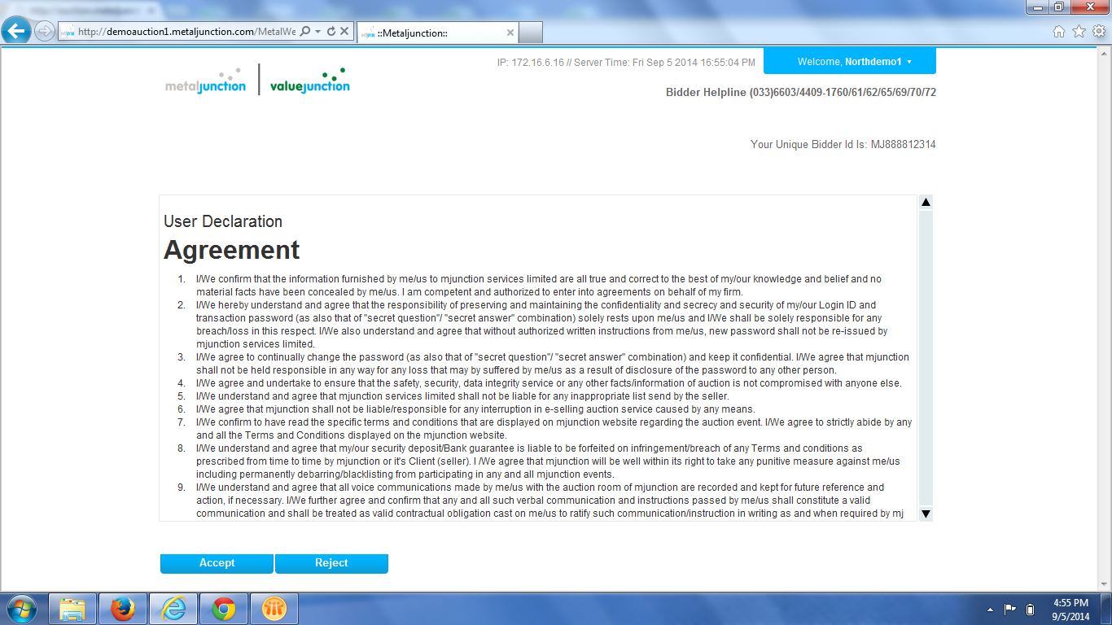
Click on Accept

Slide 4
Click on ‘Accept Catalog’

Slide 5
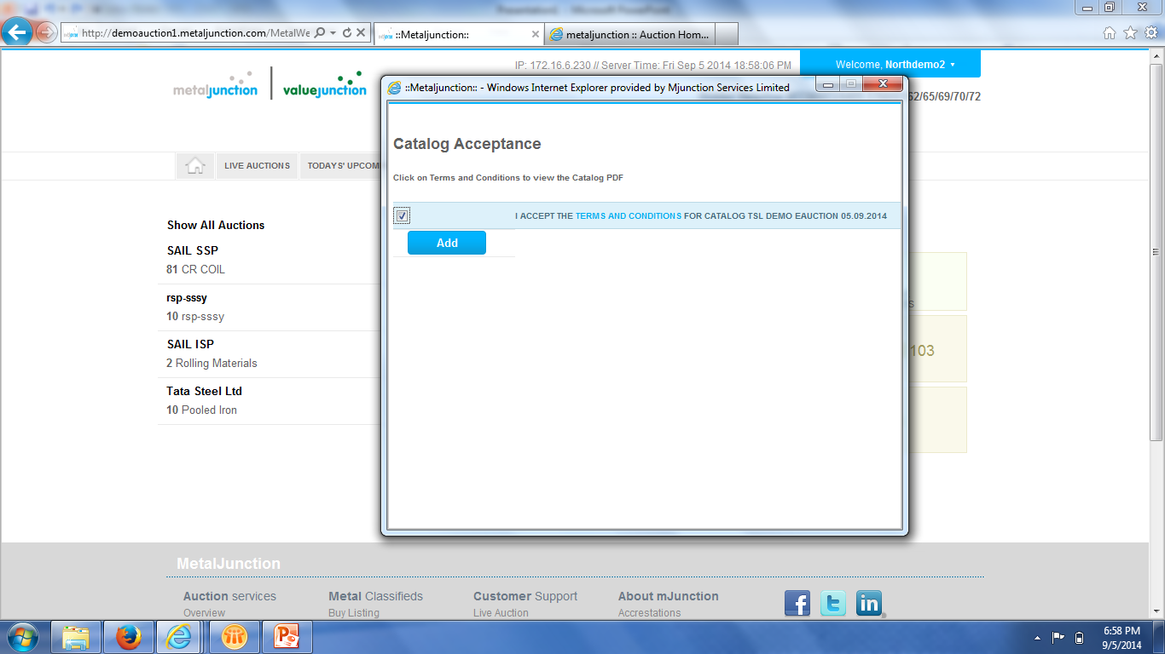
After clicking on ‘Accept Catalog’, a new dialog box opens, click on checkbox, click on ‘Add’ then click on ‘TATA Steel Ltd’ to view the Lots

Slide 6
Enter your price in ‘My Bid’, click on the checkbox and click on ‘Submit bid’. A hammer sign would appear on the left hand side if you have placed the highest bid
Lead price indicates the highest bid price for that particular lot.
How to Bid for English No Ties

Slide 7
Enter the Number of Units under ‘My Qty’, Enter your price in ‘My Bid’, click on the checkbox and click on ‘Submit bid’. Allocated quantity would be visible on the right hand side.
How to Bid for Yankee Auctions

Slide 8
If you want to view only those lots you wish to view then click on select checkbox against the lots and click on ‘Add’.
WatchList – Watchlist feature enables you to view the lots which you are interested in, so that you can concentrate and bid only on those lots.
New Feature - WATCHLIST

Slide 9
After clicking on ‘Add’, click on watchlist to view only those lots in which you are interested in.
Select on the checkbox against the lots and click on ‘Remove’ in case you want to Remove lots from the watchlist. Click on ‘Remove all’ in case you have added all the lots by mistake and reselect your lots.
New Feature - WATCHLIST

Slide 10
Move your mouse over the northdemo1 and click on ‘Profile’ to view your details.
Click on ‘Sign out’ to sign out, Click on ‘Change Password’ to change your password. Also kind take a note of your ‘Unique bidder ID’ for future correspondence with Metaljunction.

Slide 11
After clicking on ‘Profile’, you get to view this page wherein you can view your details.

Slide 12
You may customize your view by checking or unchecking the check box so that you view only those columns you need on your screen.

Slide 13
THANK YOU

